Slide 1
Data Steward
Business Constraints Knowledge
Business Objective and Success Criteria
Storytelling
Data Governance
Creativity, Passion, Curiosity
Information Architect
Operational Requirements
Analytics & BI Developer
Graphical Artisanship
Data Preparation
Analytics Guidance
Source Systems
ICT Infrastructure
Coding
Data Scientist

Slide 2
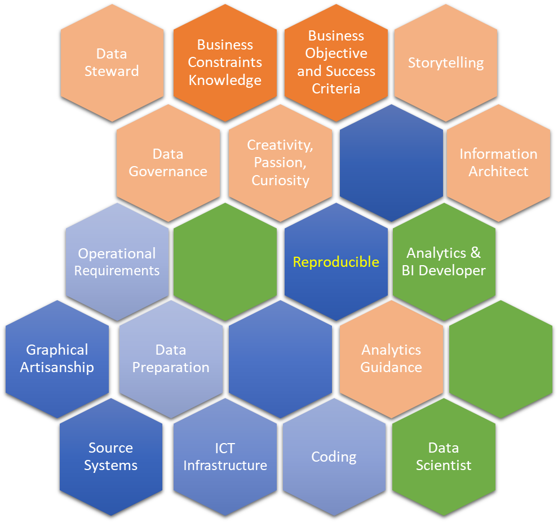
Data Steward
Business Constraints Knowledge
Business Objective and Success Criteria
Storytelling
Data Governance
Creativity, Passion, Curiosity
Information Architect
Operational Requirements
Reproducible
Analytics & BI Developer
Graphical Artisanship
Data Preparation
Analytics Guidance
Source Systems
ICT Infrastructure
Coding
Data Scientist

